Slide 1

Sentiment Analysis System
Sentiment Pro-AI

Slide 2
Introduction
Sentiment Analysis is a Natural Language Processing (NLP) technique used to determine the emotional tone behind a piece of text. It helps in identifying whether the expressed opinion is positive, negative, or neutral. This technology plays a major role in understanding user feedback and improving services across industries.
Analyzes emotions in text data
Classifies sentiment (Positive, Negative, Neutral)
Widely used in social media
Helps businesses understand customers
Based on AI and NLP techniques

Slide 3
Objective
The main objective of this project is to design and develop an intelligent sentiment analysis system that can automatically classify text into different sentiment categories. It also aims to provide deeper insights by detecting emotions and presenting results in a user-friendly format.
To build an AI-based sentiment analysis system
To classify text into multiple sentiment categories
To detect emotions beyond basic sentiment
To provide visual insights and reports

Slide 4
Key Features
Transformer-based sentiment analysis
Emotion detection (7 emotions)
Multi-language support
Keyword highlighting (explainability)
Batch processing of text files
PDF report generation
Interactive dashboards

Slide 5
Overview of System
The system takes user input in the form of text and processes it using advanced machine learning models. It analyzes the content, detects sentiment and emotions, and displays results through interactive visualizations and reports.
Accepts text input from users
Processes using AI models
Detects sentiment and emotions
Generates visual insights
Provides quick results

Slide 6
Technologies Used
This project is built using modern technologies that support machine learning and web development. Python is used as the core programming language along with various libraries for data processing, visualization, and model implementation.
Python programming language
Streamlit for web interface
Transformers library
Plotly for visualization
Translation tools for language support

Slide 7
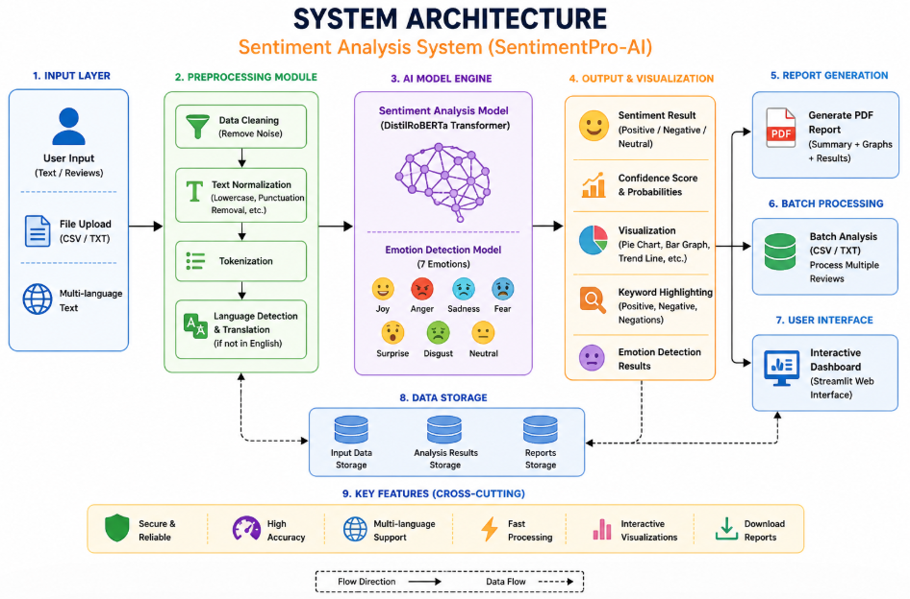
System Architecture
The system follows a structured architecture where input text is first preprocessed, then passed through a trained model for sentiment analysis. The output is then visualized and displayed to the user in an understandable format.
Input text from user
Data preprocessing stage
Model prediction phase
Emotion detection module
Output visualization

Slide 8
Sentiment Analysis
Sentiment analysis is the core functionality of this system. It evaluates the text and determines whether the sentiment expressed is positive, negative, or neutral, along with confidence scores.
Identifies sentiment polarity
Uses trained AI models
Provides confidence score
Works on different text types
Helps in decision-making

Slide 9
Emotion Detection
Beyond basic sentiment, the system also detects specific emotions present in the text. This adds deeper understanding and provides more meaningful insights into user opinions
Detects multiple emotions
Includes joy, anger, sadness, etc.
Enhances analysis depth
Uses advanced models
Improves result accuracy

Slide 10
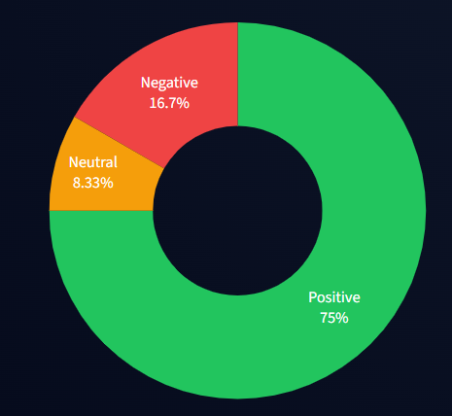
Data Visualization
The system presents results using various graphical representations to make the analysis more understandable and visually appealing. These visualizations help users quickly interpret the data.
Uses charts and graphs
Pie chart for sentiment distribution
Bar graphs for comparison
Trend analysis visualization
Easy to understand outputs

Slide 11
Applications
Sentiment analysis has a wide range of applications in different industries. It is especially useful for analyzing customer opinions, social media data, and product feedback.
Social media monitoring
Product review analysis
Customer feedback evaluation
Market research
Brand reputation management

Slide 12
Conclusion
The sentiment analysis system is a powerful tool that leverages AI to understand human emotions from text. It provides accurate insights, supports multiple features, and can be extended for real-world applications.
Combines AI and NLP
Provides accurate results
User-friendly interface
Useful in many industries
Scope for future improvements

Slide 13
Thank You
Nafeesa Shaik
Manogna Uppu
Kavyanjali Talluri
Kusumanjali Somisetty

